Slide 1
Vision: Real-Time Motion Detection and Analysis
Mini Project Presentation
Project By:
Archit (2401410009)
Chanchal (2401410011)
Alishna (2401410013)
Chetna (2401410028)

Slide 2

Introduction
This project implements a real-time motion detection and analysis system using a webcam, built with Python and OpenCV.

Slide 3
Problem Statement
Traditional surveillance creates redundant data and lacks motion classification and intelligent response. Our system addresses this.

Slide 4
Objectives
• Detect and classify motion
• Detect direction & zone
• Log and store motion intelligently

Slide 5

Technologies Used
• Python 3.x
• OpenCV
• NumPy
• Winsound
• Datetime
• OS & Threading

Slide 6
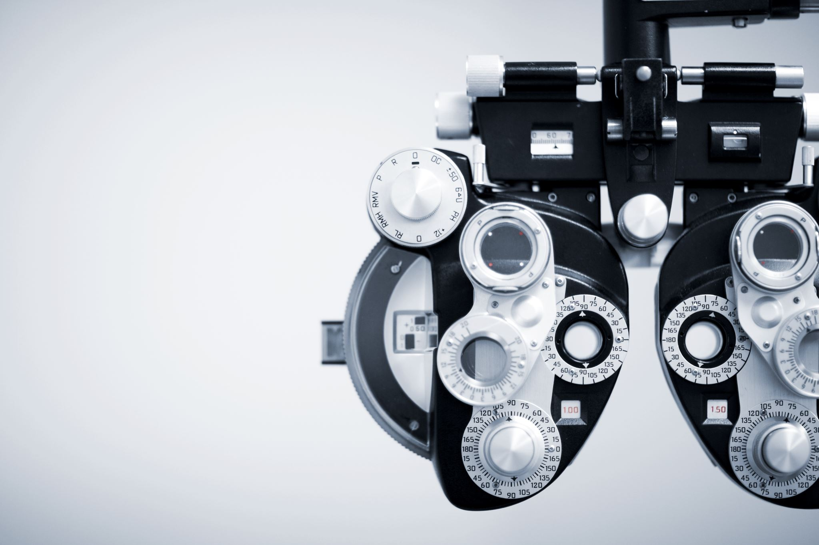
Motion Detection Logic
Uses frame differencing and contour detection on live webcam feed to identify moving objects.

Slide 7
Motion Classification
Small: <1500 px
Medium: <4000 px
Big: <8000 px
•Extreme: ≥8000 px

Slide 8

Direction & Zone Detection
Screen divided into 9 zones. Motion direction is detected based on center point movement between frames.

Slide 9
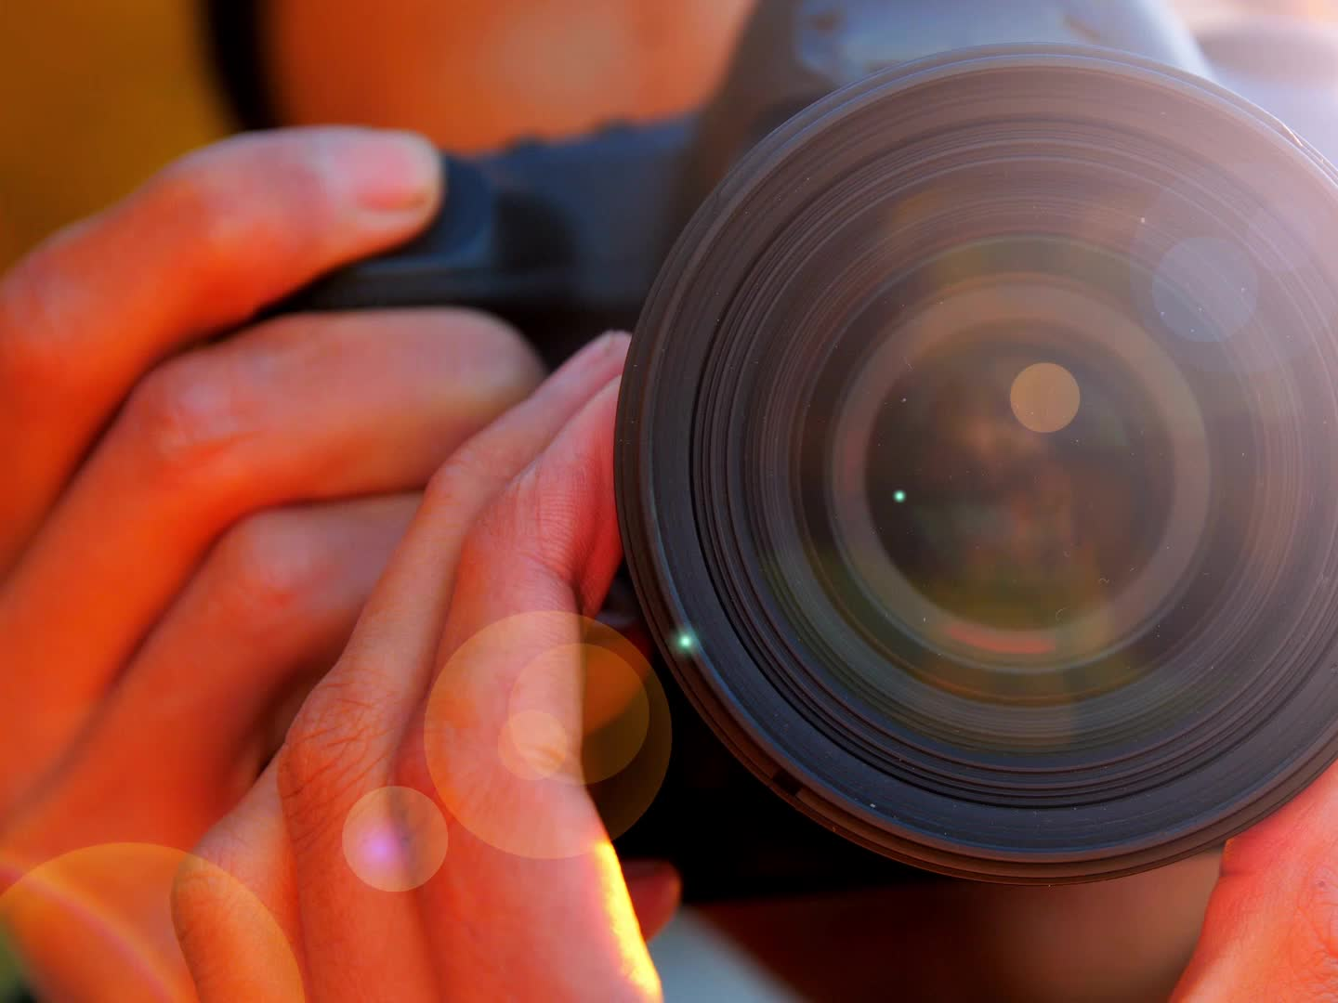
Snapshot & Logging
Snapshots are saved in categorized folders and motion events are logged with timestamps.

Slide 10

Real-Time GUI Overlay
Overlay shows time, motion count, intensity, direction, and zone in real-time.

Slide 11
Future Scope
• Sound Alerts
• Email/Telegram Alerts
• Cloud Storage
• Multi-Camera Support
• Object Detection
• Web Dashboard

Slide 12
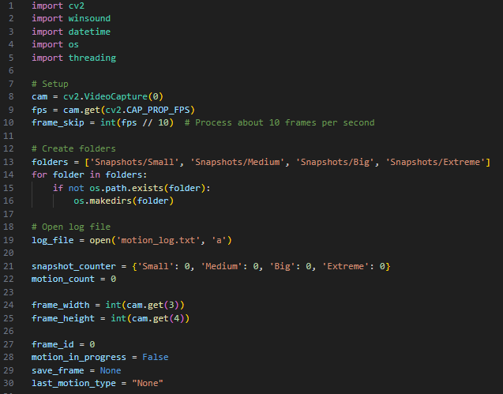
System Setup & Folder Creation

Slide 13
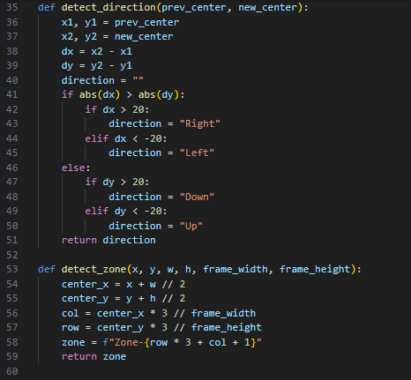
Motion Detection & Classification

Slide 14
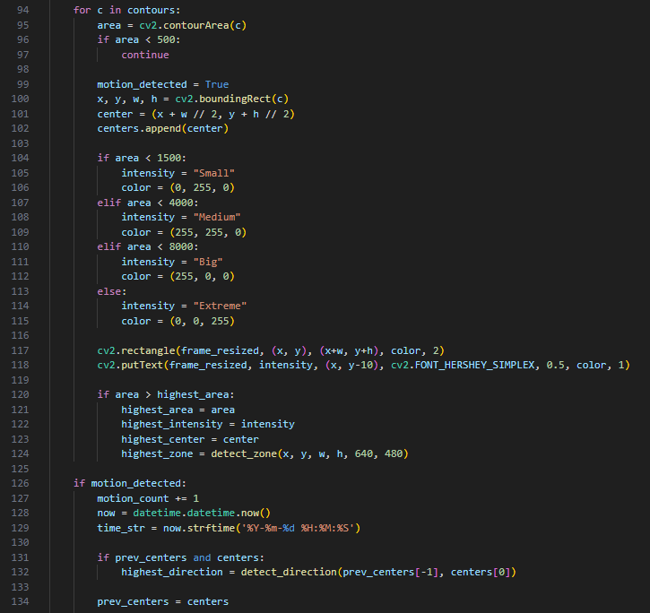
Motion Detection & Classification

Slide 15
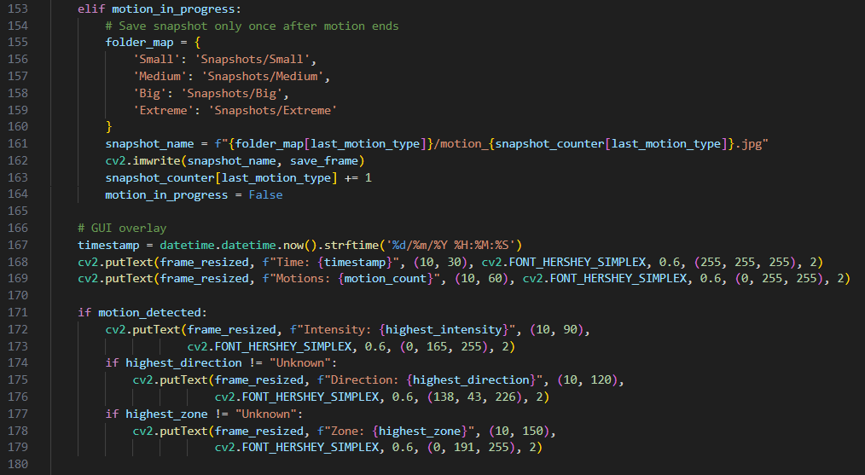
Snapshot Saving & GUI overlay

Slide 16

Thank You
Archit (2401410009)
Chanchal (2401410011)
Alishna (2401410013)
Chetna (2401410028)

